Slide 1
Regression and Correlation methods

Slide 2
Learning Objectives
Describe the Linear Regression Model
State the Regression Modeling Steps
Explain Ordinary Least Squares
Compute Regression Coefficients
Understand and check model assumptions
Predict Response Variable
Notes:
As a result of this class, you will be able to...

Slide 3
Models
Notes:
3

Slide 4

What is a Model?
Representation of
Some Phenomenon
Non-Math/Stats Model
Representation of
Some Phenomenon
Non-Math/Stats Model
Notes:
.

Slide 5
What is a Math/Stats Model?
Describe Relationship between Variables
Types
    Deterministic Models (no randomness)
    Probabilistic Models (with randomness)
Notes:
.

Slide 6
Deterministic Models
Hypothesize Exact Relationships
Suitable When Prediction Error is Negligible
Example: Body mass index (BMI) is measure of body fat based
  Metric Formula: BMI = Weight in Kilograms
  (Height in Meters)²
  Non-metric Formula: BMI = Weight (pounds)x703
  (Height in inches)²

Slide 7
Probabilistic Models
Hypothesize 2 Components
    Deterministic
    Random Error
Example: Systolic blood pressure of newborns Is 6 Times the Age in days + Random Error
    SBP = 6xage(d) + ε
    Random Error May Be Due to Factors Other Than age in days (e.g. Birthweight)

Slide 8
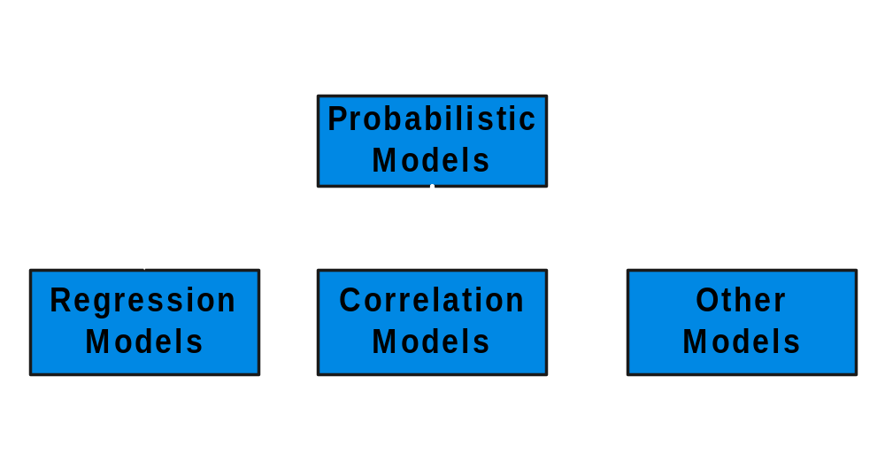
Types of
Probabilistic Models
Notes:
7

Slide 9
Regression Models
Notes:
13

Slide 10
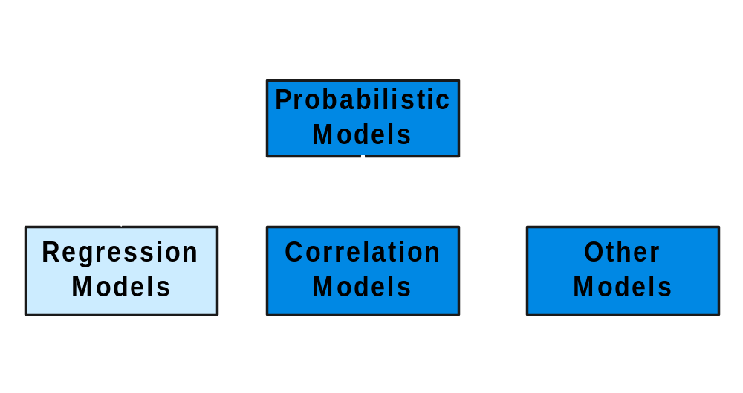
Types of
Probabilistic Models
Notes:
7

Slide 11
1. Regression Models
Relationship between one dependent variable and explanatory variable(s)
Use equation to set up relationship
    Numerical Dependent (Response) Variable
    1 or More Numerical or Categorical Independent (Explanatory) Variables
Used Mainly for Prediction & Estimation

Slide 12
2. Regression Modeling Steps
1. Hypothesize Deterministic Component
    Estimate Unknown Parameters
2. Specify Probability Distribution of Random Error Term
    Estimate Standard Deviation of Error
3. Evaluate the fitted Model
4. Use Model for Prediction & Estimation

Slide 13
Model Specification
Notes:
13

Slide 14
Specifying the deterministic component
1. Define the dependent variable and independent variable
2. Hypothesize Nature of Relationship
  Expected Effects (i.e., Coefficients’ Signs)
  Functional Form (Linear or Non-Linear)
  Interactions

Slide 15

Model Specification
Is Based on Theory
1. Theory of Field (e.g., Epidemiology)
2. Mathematical Theory
3. Previous Research
4. ‘Common Sense’

Slide 16
Types of
Regression Models
Notes:
18
This teleology is based on the number of explanatory variables & nature of relationship between X & Y.

Slide 17
Types of
Regression Models
Regression
Models
EPI 809/Spring 2008
Notes:
19
This teleology is based on the number of explanatory variables & nature of relationship between X & Y.

Slide 18
Types of
Regression Models
1 Explanatory
Regression
Variable
Models
Simple
EPI 809/Spring 2008
Notes:
20
This teleology is based on the number of explanatory variables & nature of relationship between X & Y.

Slide 19
Types of
Regression Models
1 Explanatory
Regression
2+ Explanatory
Variable
Models
Variables
Simple
Multiple
EPI 809/Spring 2008
Notes:
21
This teleology is based on the number of explanatory variables & nature of relationship between X & Y.

Slide 20
Types of
Regression Models
1 Explanatory
Regression
2+ Explanatory
Variable
Models
Variables
Simple
Multiple
Linear
EPI 809/Spring 2008
Notes:
22
This teleology is based on the number of explanatory variables & nature of relationship between X & Y.

Slide 21
Types of
Regression Models
1 Explanatory
Regression
2+ Explanatory
Variable
Models
Variables
Simple
Multiple
Non-
Linear
Linear
EPI 809/Spring 2008
Notes:
23
This teleology is based on the number of explanatory variables & nature of relationship between X & Y.

Slide 22
Types of
Regression Models
1 Explanatory
Regression
2+ Explanatory
Variable
Models
Variables
Simple
Multiple
Non-
Linear
Linear
Linear
EPI 809/Spring 2008
Notes:
24
This teleology is based on the number of explanatory variables & nature of relationship between X & Y.

Slide 23
Types of
Regression Models
1 Explanatory
Regression
2+ Explanatory
Variable
Models
Variables
Simple
Multiple
Non-
Non-
Linear
Linear
Linear
Linear
Notes:
24
This teleology is based on the number of explanatory variables & nature of relationship between X & Y.

Slide 24
Linear Regression Model
Notes:
26

Slide 25
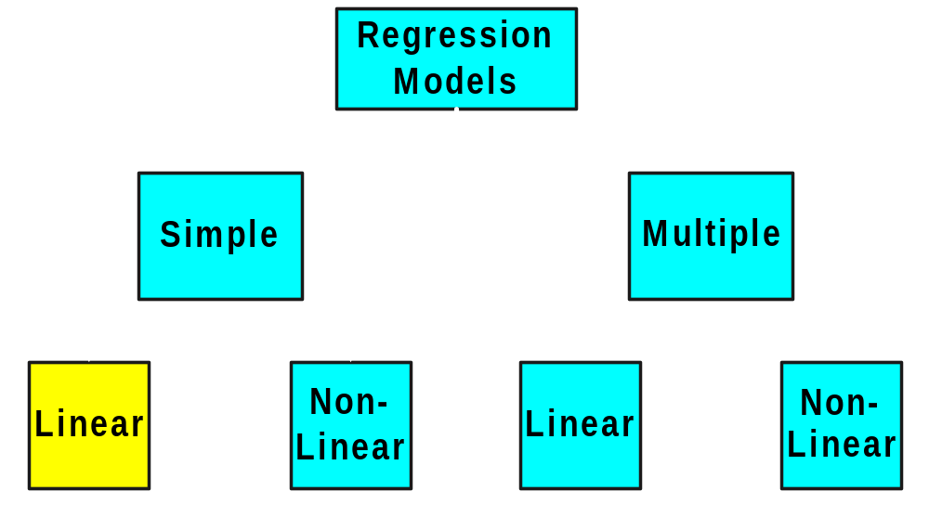
Types of
Regression Models
Notes:
27
This teleology is based on the number of explanatory variables & nature of relationship between X & Y.

Slide 26
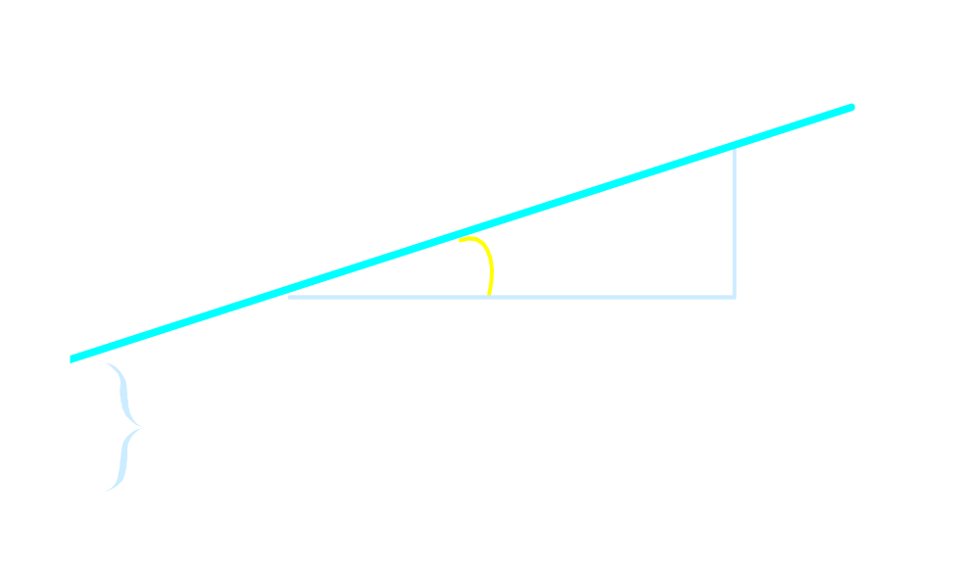

Linear Equations
© 1984-1994 T/Maker Co.
Notes:
28

Slide 27
Linear Regression Model
1. Relationship Between Variables Is a Linear Function
Population
Y-Intercept
Population Slope
Random Error
Y
=
β
+
β
X
+
ε
i
0
1
i
i
Dependent (Response) Variable
Independent (Explanatory) Variable

Slide 28
Population & Sample Regression Models
Notes:
30

Slide 29
Population & Sample Regression Models
Population
☺
☺
☺
☺
☺
Notes:
31

Slide 30

Population & Sample Regression Models
Population
Unknown Relationship
☺
☺
☺
☺
☺
Notes:
32

Slide 31
Population & Sample Regression Models
Population
Random Sample
Unknown Relationship
☺
☺
☺
☺
☺
☺
☺
Notes:
33

Slide 32
Population & Sample Regression Models
Population
Random Sample
Unknown Relationship
☺
☺
☺
☺
☺
☺
☺
Notes:
34

Slide 33
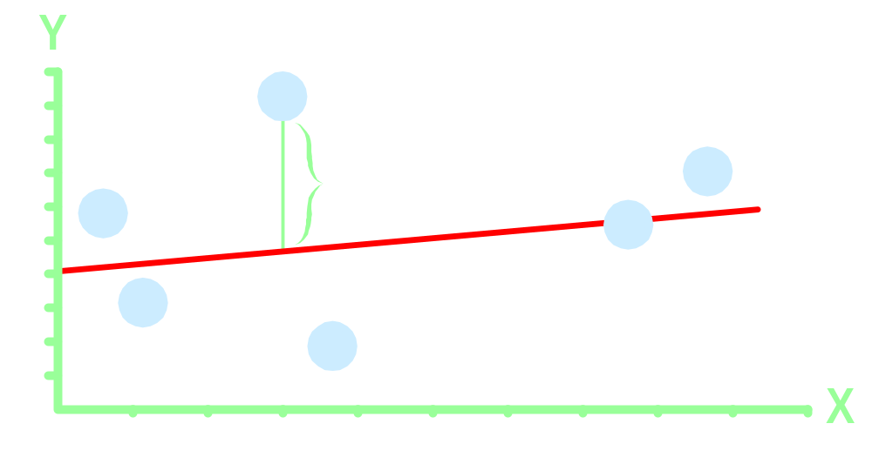
Population Linear Regression Model
Observedvalue
ε_{i} = Random error
Observed value
Notes:
35

Slide 34
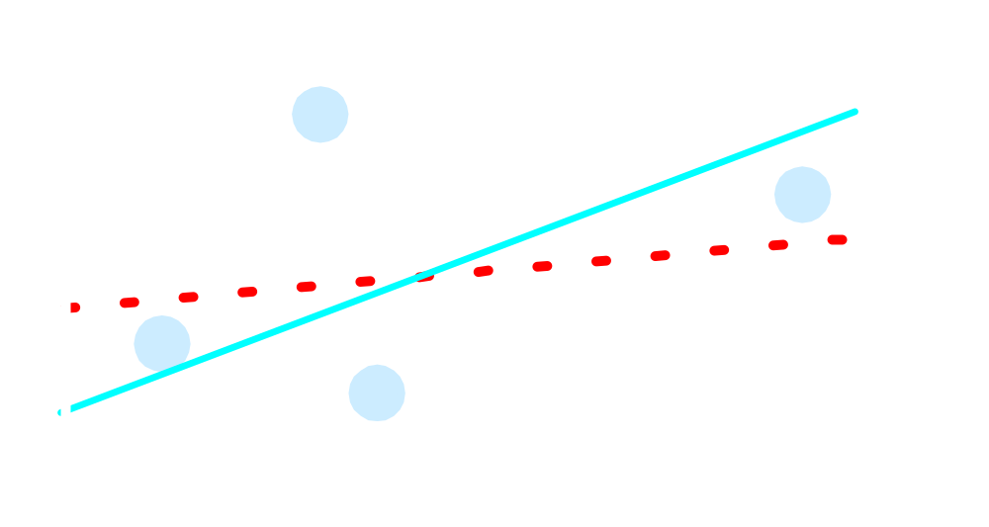
Sample Linear Regression Model
ε_{i} = Random error
^
Unsampled observation
Observed value
Notes:
36

Slide 35
3. Estimating Parameters:
Least Squares Method
Notes:
40

Slide 36
Scatter plot
1. Plot of All (X_{i}, Y_{i}) Pairs
2. Suggests How Well Model Will Fit
Y
60
40
20
0
X
0
20
40
60

Slide 37
Thinking Challenge
How would you draw a line through the points? How do you determine which line ‘fits best’?
Y
60
40
20
0
X
0
20
40
60
Notes:
42

Slide 38
Thinking Challenge
How would you draw a line through the points? How do you determine which line ‘fits best’?
Slope changed
Y
60
40
20
0
X
0
20
40
60
Intercept unchanged
Notes:
43

Slide 39
Thinking Challenge
How would you draw a line through the points? How do you determine which line ‘fits best’?
Slope unchanged
Y
60
40
20
0
X
0
20
40
60
Intercept changed
Notes:
44

Slide 40
Thinking Challenge
How would you draw a line through the points? How do you determine which line ‘fits best’?
Slope changed
Y
60
40
20
0
X
0
20
40
60
Intercept changed
Notes:
45

Slide 41
Least Squares
1. ‘Best Fit’ Means Difference Between Actual Y Values & Predicted Y Values Are a Minimum. But Positive Differences Off-Set Negative ones
Notes:
49

Slide 42
Least Squares
1. ‘Best Fit’ Means Difference Between Actual Y Values & Predicted Y Values is a Minimum. But Positive Differences Off-Set Negative ones. So square errors!
Notes:
50

Slide 43
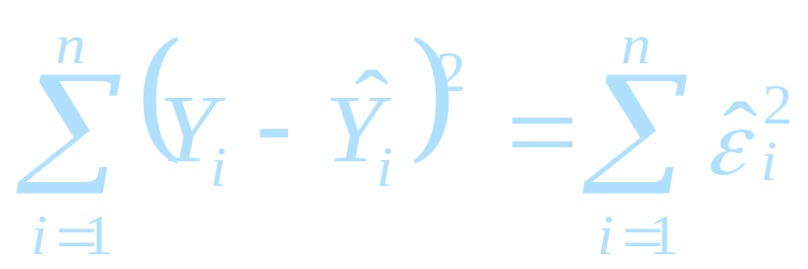
Least Squares
1. ‘Best Fit’ Means Difference Between Actual Y Values & Predicted Y Values Are a Minimum. But Positive Differences Off-Set Negative. So square errors!
2. LS Minimizes the Sum of the Squared Differences (errors) (SSE)
Notes:
51

Slide 44
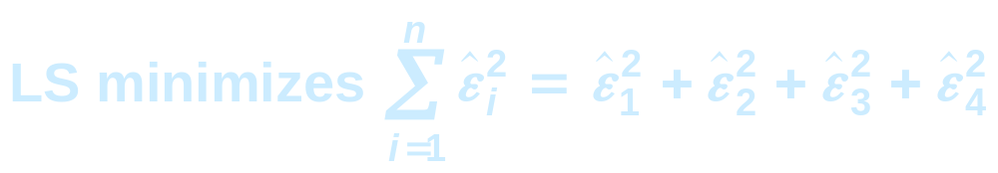
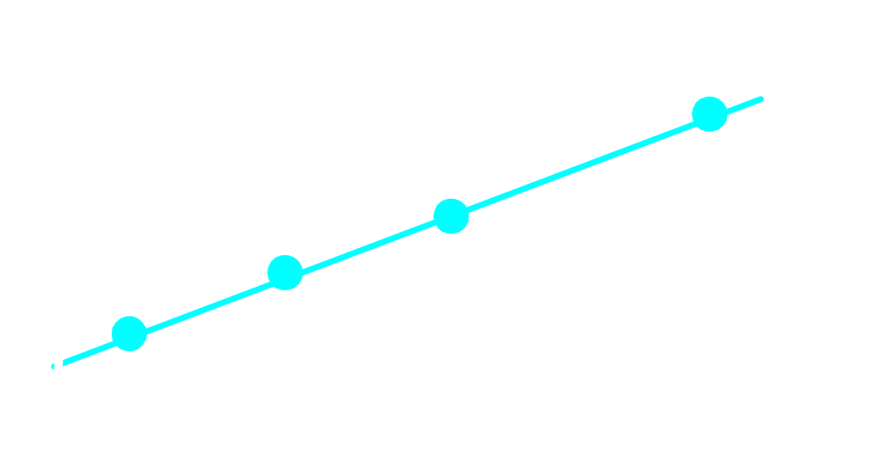
Least Squares Graphically
Notes:
52

Slide 45
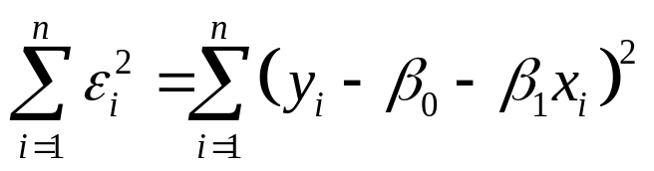
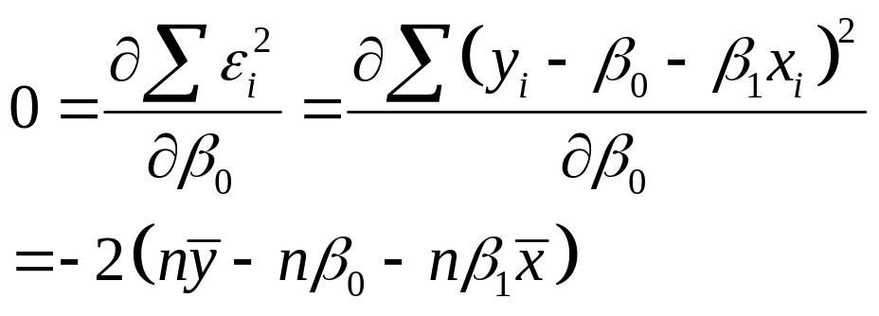
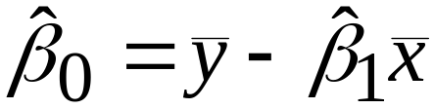
Derivation of Parameters (1)
Least Squares (L-S):
Minimize squared error

Slide 46
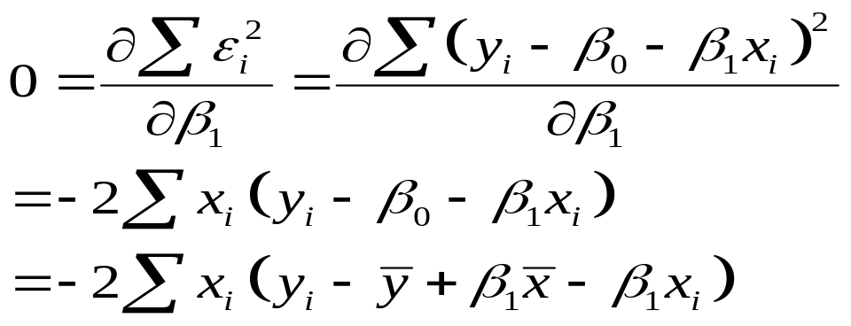
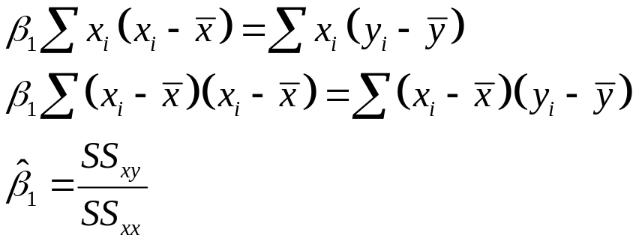
Derivation of Parameters (1)
Least Squares (L-S):
Minimize squared error

Slide 47
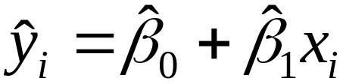
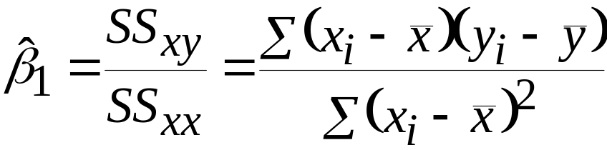
4. Coefficient Equations
Prediction equation
Sample slope
Sample Y - intercept

Slide 48
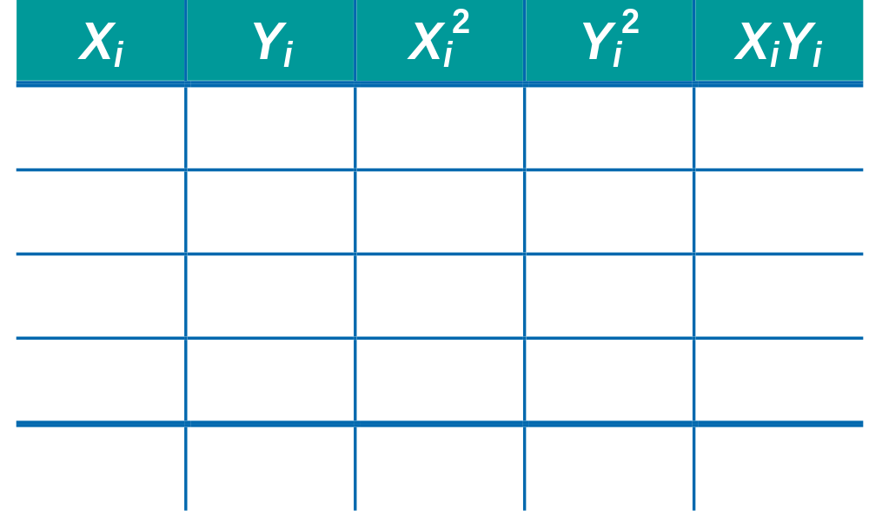
Computation Table
Notes:
54

Slide 49
Interpretation of Coefficients
5. Understand & Check Model
Assumption

Slide 50
Interpretation of Coefficients
^
1. Slope (β₁)
  Estimated Y Changes by β₁ for Each 1 Unit Increase in X
    If β₁ = 2, then Y Is Expected to Increase by 2 for Each 1 Unit Increase in X
^
^

Slide 51
Interpretation of Coefficients
^
1. Slope (β₁)
  Estimated Y Changes by β₁ for Each 1 Unit Increase in X
    If β₁ = 2, then Y Is Expected to Increase by 2 for Each 1 Unit Increase in X
2. Y-Intercept (β₀)
  Average Value of Y When X = 0
    If β₀ = 4, then Average Y Is Expected to Be 4 When X Is 0
^
^
^
^

Slide 52
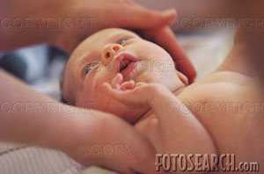
Parameter Estimation Example
Obstetrics: What is the relationship between
Mother’s Estriol level & Birthweight using the following data?
Estriol Birthweight
(mg/24h) (g/1000)
1 1
2 1
3 2
4 2
5 4

Slide 53

Scatterplot
Birthweight vs. Estriol level
Birthweight
Estriol level
Notes:
57

Slide 54
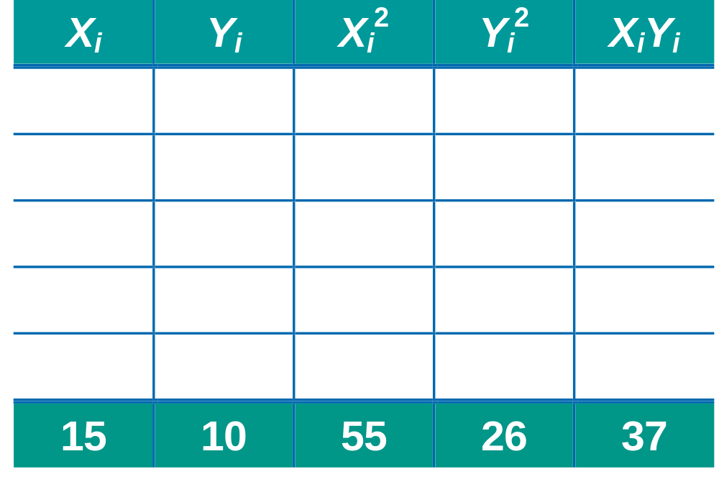
Parameter Estimation Solution Table
Notes:
58

Slide 55
Parameter Estimation Solution
Notes:
59

Slide 56
Coefficient Interpretation Solution

Slide 57
Coefficient Interpretation Solution
^
1. Slope (β₁)
  Birthweight (Y) Is Expected to Increase by .7 Units for Each 1 unit Increase in Estriol (X)

Slide 58
Coefficient Interpretation Solution
^
1. Slope (β₁)
  Birthweight (Y) Is Expected to Increase by .7 Units for Each 1 unit Increase in Estriol (X)
2. Intercept (β₀)
  Average Birthweight (Y) Is -.10 Units When Estriol level (X) Is 0
    Difficult to explain
    The birthweight should always be positive
^

Slide 59

Parameter Estimation Thinking Challenge
You’re a Vet epidemiologist for the county cooperative. You gather the following data:
Food (lb.) Milk yield (lb.)
4 3.0
6 5.5
10 6.5
12 9.0
What is the relationship
between cows’ food intake and milk yield?
© 1984-1994 T/Maker Co.
Notes:
62

Slide 60

Scattergram
Milk Yield vs. Food intake*
M. Yield (lb.)
Food intake (lb.)
Notes:
65

Slide 61
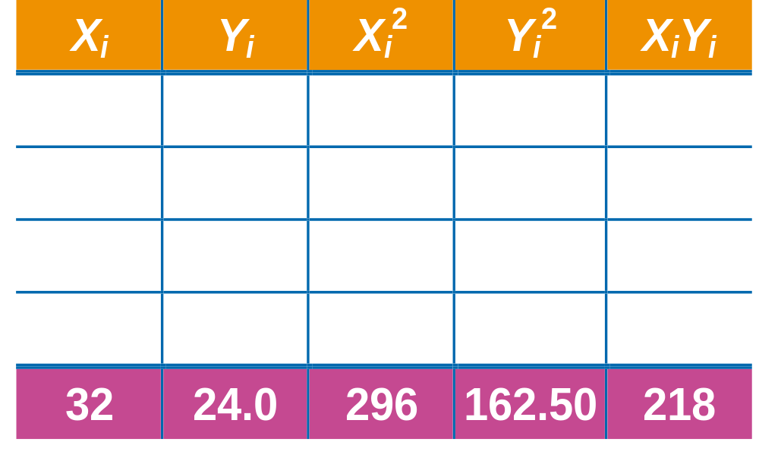
Parameter Estimation Solution Table*
Notes:
66

Slide 62
Parameter Estimation Solution*
Notes:
67

Slide 63
Coefficient Interpretation Solution*

Slide 64
Coefficient Interpretation Solution*
^
1. Slope (β₁)
  Milk Yield (Y) Is Expected to Increase by .65 lb. for Each 1 lb. Increase in Food intake (X)

Slide 65
Coefficient Interpretation Solution*
^
1. Slope (β₁)
  Milk Yield (Y) Is Expected to Increase by .65 lb. for Each 1 lb. Increase in Food intake (X)
2. Y-Intercept (β₀)
  Average Milk yield (Y) Is Expected to Be 0.8 lb. When Food intake (X) Is 0
^

Slide 66
THANK YOU!
EPI 809/Spring 2008

